Slide 1


Slide 2

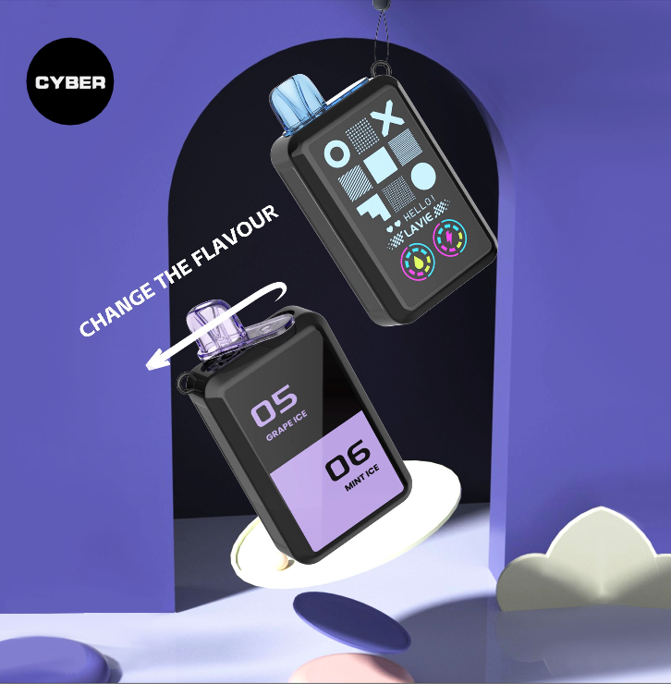
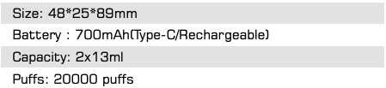

20KPUFFS
LAVIE CYBER
(2 saboes)

Slide 3

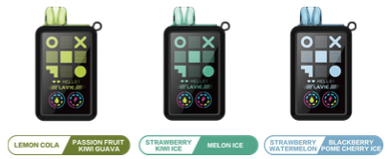
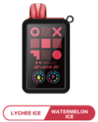
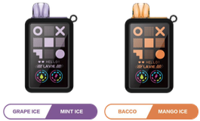
SABORES DISPONIBLES
PASSION FRUIT
MIN ICE
BLACKBERRRY
WATERMELON
MIN ICE
MANGO

Slide 4
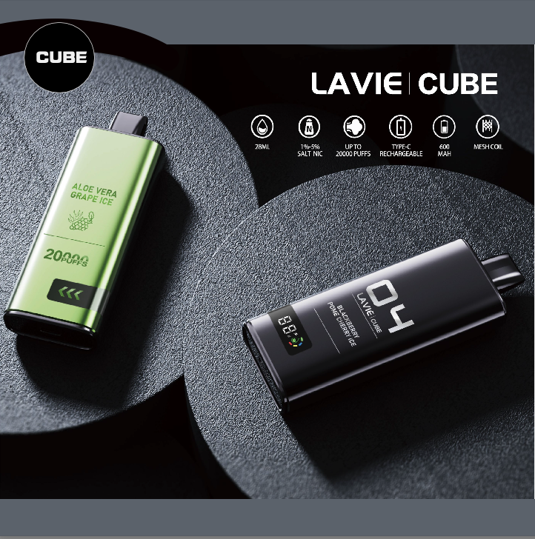
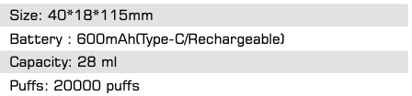
20KPUFFS
LAVIER CUBE

Slide 5
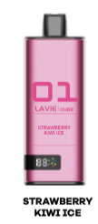
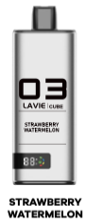
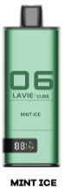
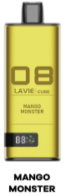
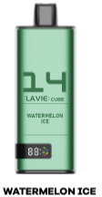
SABORES DISPONIBLES
STRABERRY KIWI ICE
STRAWBERRY/WATERMELON
MIN ICE
MANGO
MATERMELON ICE

Slide 6
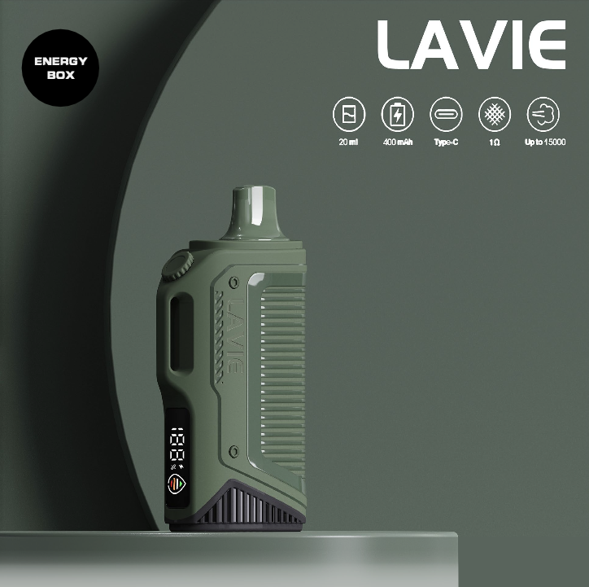
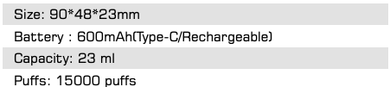
15KPUFFS
LAVIE ENERGY

Slide 7
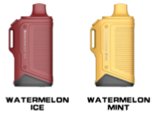
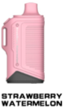
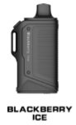
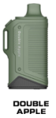
SABORES DISPONIBLES
WATERMELON ICE
WATERMELON MINT
STRAWBERRY WATERMELON
DOUBLE APPLE

Slide 8
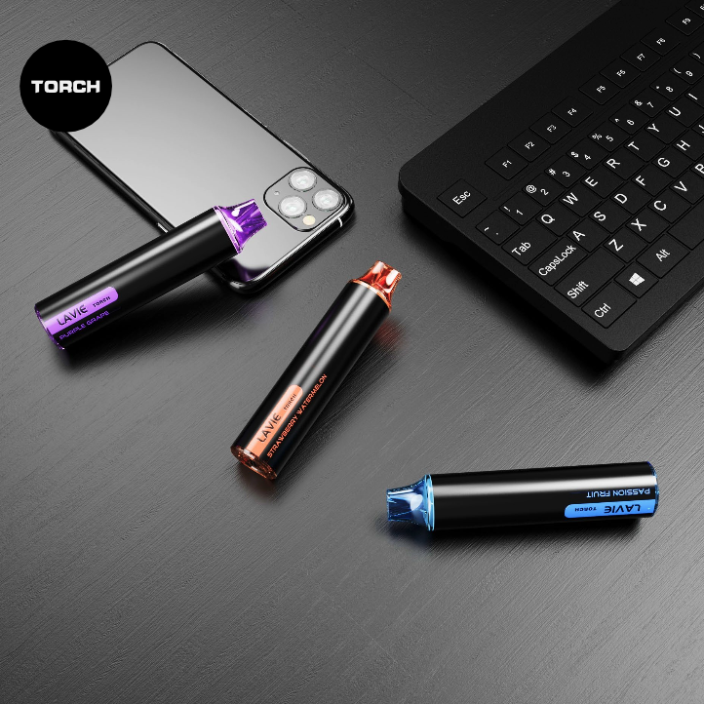
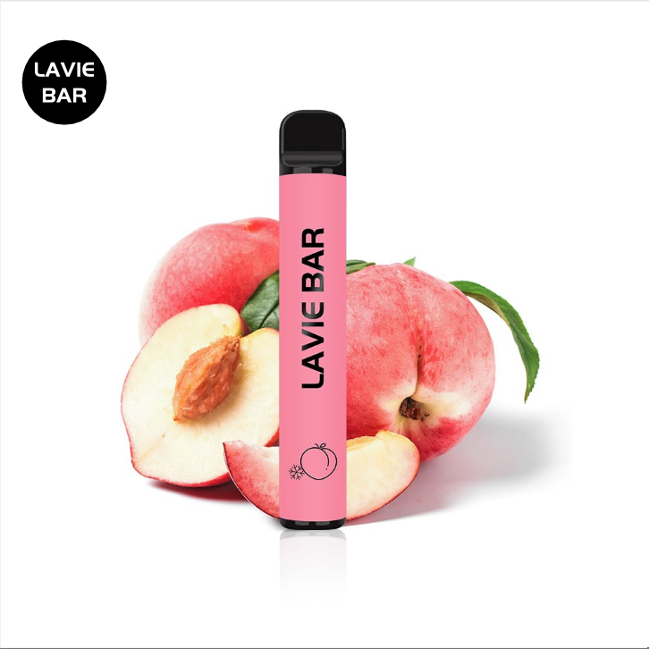
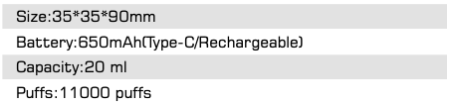
6K
PUFFS
LAVIER TORCH

Slide 9
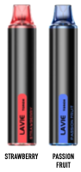
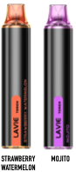
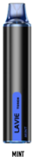
SABORES DISPONIBLES
STRAWVERRY
PASION FRUIT
MIXED BERRRIES
MOJITO
MINT

Slide 10
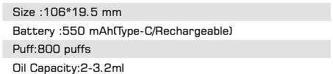
800
PUFFS
LAVIER BAR

Slide 11
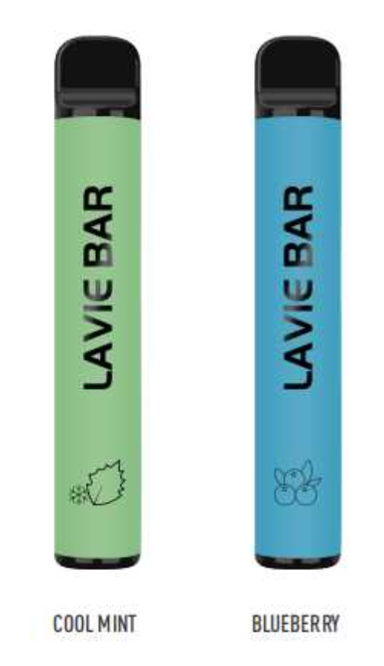
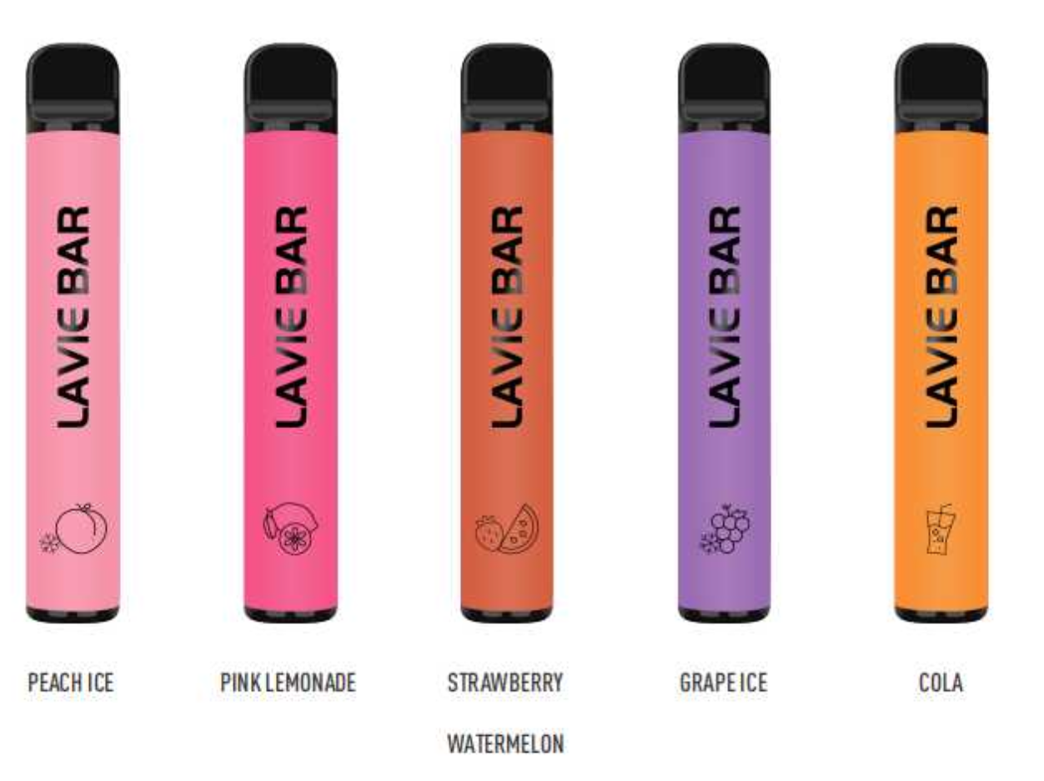
SABORES DISPONIBLES
Menta Fresca
Arandanos
Fresa/sandia
Hielo de Uva
Hielo de Durazno

